Slide 1
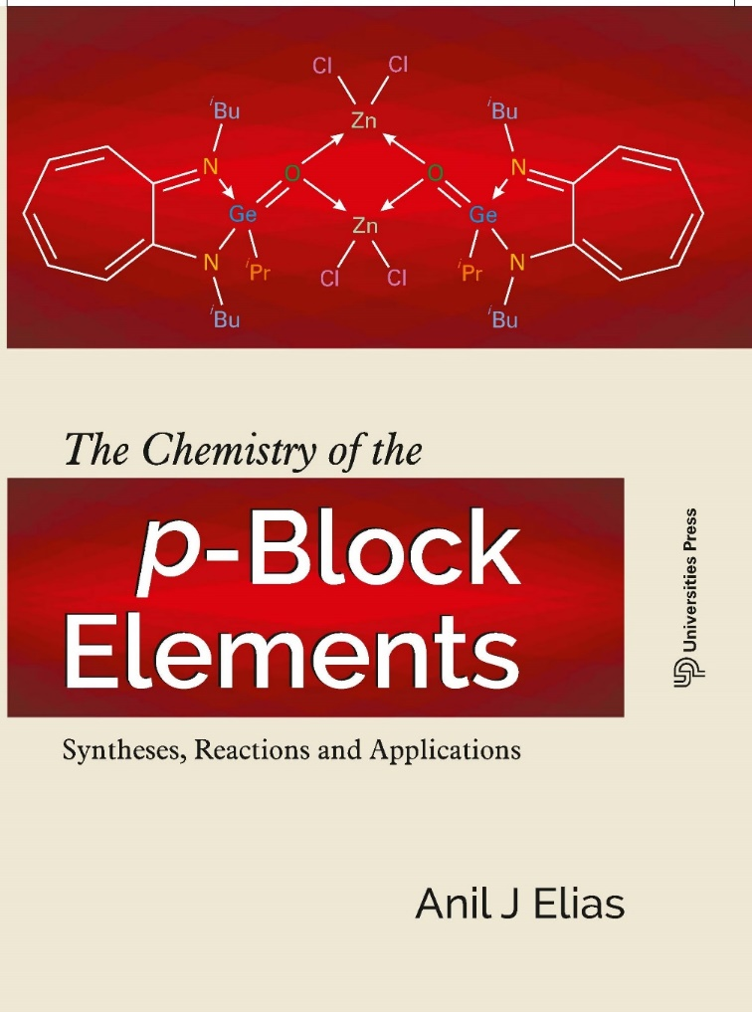
Chemistry of Nitrogen
For more details refer chapter 8 of the book
‘The Chemistry of the p-Block elements: Syntheses, reactions and applications, 2018 Universities Press
The Explosive Chemistry of Nitrogen*
A Fascinating Journey From 9th Century to the Present
Dheeraj Kumar and Anil J Elias
*DOI: https://doi.org/10.1007/s12045-019-0893-2
RESONANCE | November 2019

Slide 2
Unique properties of nitrogen and its compounds
Nitrogen gas N₂, forms 78.09% of the earth’s atmosphere which amounts to an estimated 4,000 trillion tons.
Unlike O₂, N₂ is quite stable in the atmosphere and does not get involved much in chemical reactions. Thus, over geological time, it has built up in the atmosphere to a much greater extent than oxygen.
Nitrogen is the most widely used blanketing and purging gas for maintaining an inert atmosphere in metallurgy, chemical reactions, storage of flammable compounds and protecting compounds which are prone to air oxidation such as vegetable oils.
Since it is non combustible, unreactive and available in plenty, N₂ is also used for generating high pressure to force crude oil to reach earth’s surface. As such it is slightly soluble in water (two liters in 100 liters of water).
N≡N is the second strongest bond known with a bond dissociation enthalpy of 945 kJ/mol.
Nitrogen is an essential element for life and is present basically in proteins as amino acid units.
Nitrogen shows oxidation states -3 (NH₃),-2 (N₂H₄), -1 (NH₂OH), 0 (N₂), +1 (N₂O), +2 (NO), +3(HNO₂), +4 (NO₂) and +5 (HNO₃) in its compounds.
Ammonia is one of the most industrially important inorganic compounds and a precursor to almost all nitrogen based compounds, such as nitric acid, nitrogen based fertilizers and many explosives.

Slide 3
Rhizobia bacteria present on root nodules of leguminous plants convert atmospheric nitrogen to ammonia which is further converted to soluble nitrates by nitrifying bacteria (Nitrogen fixation)
Compounds of nitrogen has three major industrial applications. Fertilizers (Ammonia, ammonium salts, Urea), explosives (organic nitro and polynitrogen compounds) and as an inhalation anesthetic (Nitrous oxide)
Nitric oxide, NO, which is produced by the endothelium cells of blood vessels, acts as a vasodilator, relaxing blood vessels thereby increasing blood flow and reducing blood pressure.
Linear Azide (N₃⁻), bent pentazenium (N₅⁺) and cyclic pentazolate (N₅⁻) are polynitrogen compounds which are highly shock sensitive.
The formation of the very strong N≡N is the main driving force behind the detonating property of all nitrogen based explosives.

Slide 4
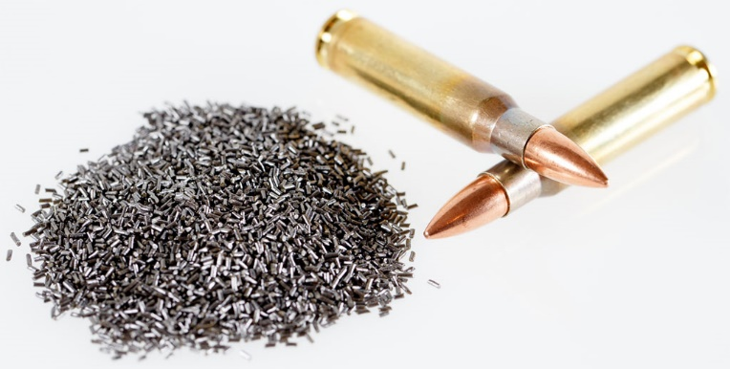
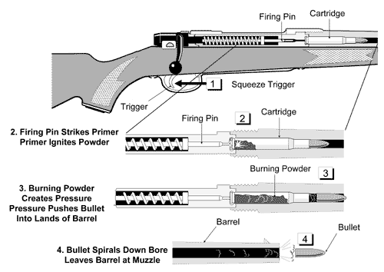
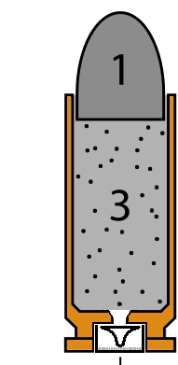

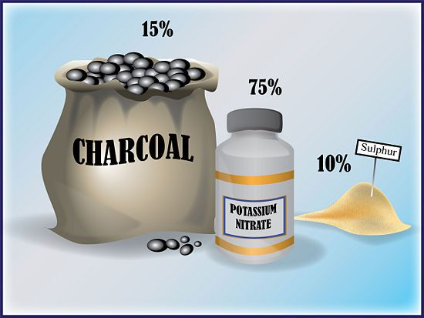
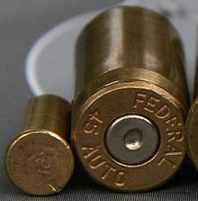
The early world’s need for potassium nitrate was for making gunpowder
In the 9th century, Chinese alchemists discovered gunpowder (also called black powder) which is a combination of sulfur, charcoal and potassium nitrate. Europeans brought this technology to main land Europe in the 13th century. Potassium nitrate (75%) was the main ingredient of gunpowder

Slide 5

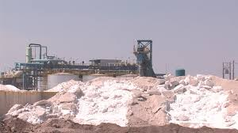
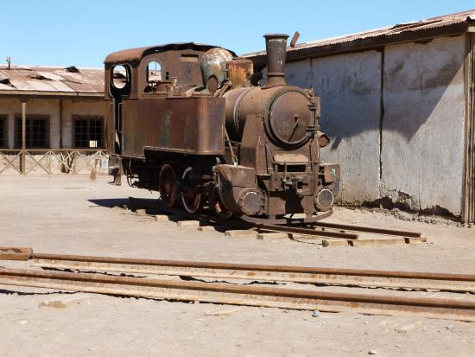
Early sources of nitrate salts: Guano, Chile Salt Peter and Bengal Salt Peter
NaNO3 mines of Attacama desert, Chile
One of the early sources of nitrate was Guano, which is basically excrements of sea birds and bats which was high in potassium nitrate. The biggest source was Atacama Desert of Chile where sodium nitrate was available in plenty (known by the name ‘Chile saltpetre’ as part of a mineral called Caliche). By 1859, the British were importing as much as 47,000 metric tonnes of Chile saltpetre for use of the Royal army.
Potassium nitrate has also been harvested from the soil of certain parts of Bihar and Bengal after a monsoon season. This has been called ‘Bengal Salt Peter’ and was exported to England during the British rule of India for making gunpowder

Slide 6
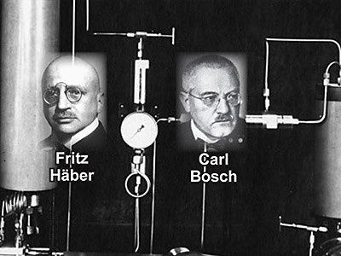
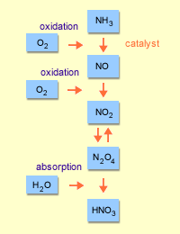
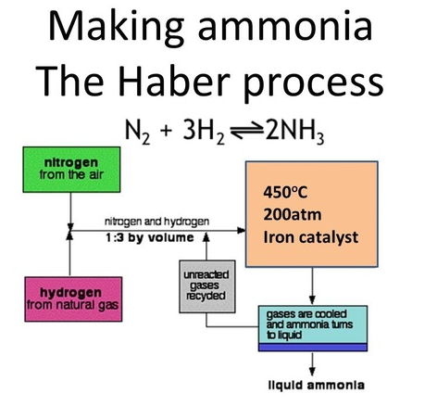
During the first world war in the period 1914-1918, Chile saltpetre was in very high demand for making ammunitions. Europeans and Americans were in the Atacama Desert trying to mine the mineral Caliche which contained NaNO₃ and ship it out to their countries. The enemies of Germany especially the British blocked the German ships from getting access to Chile saltpetre. Germans have meantime discovered that ammonia can be oxidized to nitric oxide and further converted to nitric acid which can be used for making explosive nitrates. So, Germans focused on finding ways to make ammonia from atmospheric nitrogen and a very smart chemist by name Fritz Haber succeeded in making ammonia by mixing hydrogen and nitrogen and passing the mixture over a heated osmium catalyst at high pressure. Freidrich Ostwald’s process for oxidation of ammonia to nitric oxide helped in making nitric acid.

Slide 7
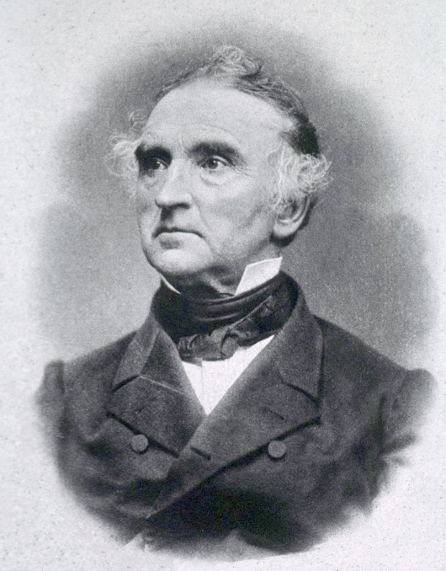
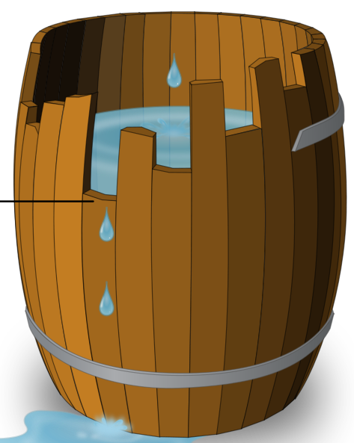
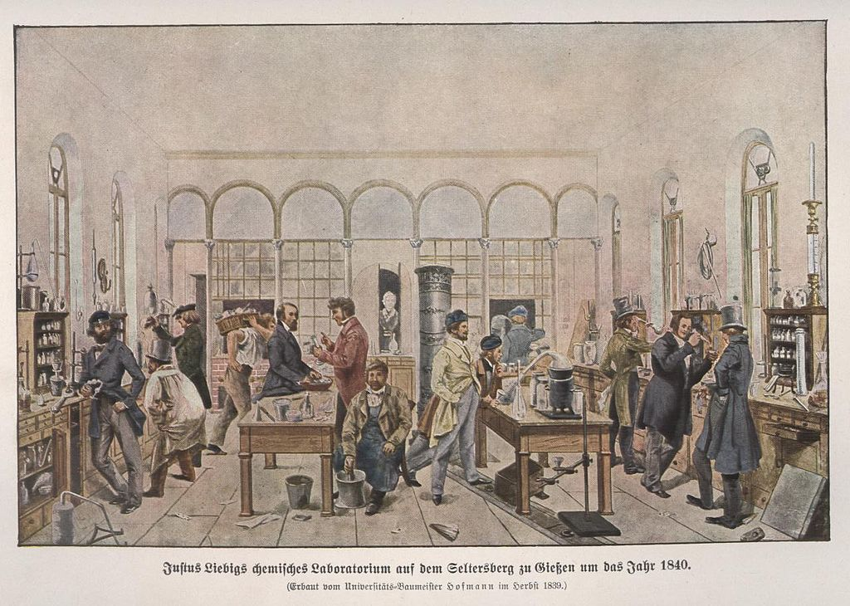
Father of the chemical fertilizers
The man who predicted the N P K requirement for plant growth
In his theory of mineral nutrients, Liebig identified the chemical elements of nitrogen (N), phosphorus (P), and potassium (K) as essential to plant growth.
Book by Liebig on Plant growth: Die organische Chemie in ihrer Anwendung auf Agricultur und Physiologie (Organic Chemistry in its Application to Agriculture and Physiology) (1840)
Liebig's barrel
N P K
3 1 2
Liebig believed that nitrogen could be supplied in the form of ammonia and recognized the possibility of substituting chemical fertilizers for natural ones
Justus von Liebig Philosopher and Chemist
Devised the modern laboratory-oriented teaching method
1803-1873
Liebig taught the world two great lessons.
In order to teach chemistry it was necessary that students should be taken into a laboratory.
2. To apply scientific thought and method to industrial problems one must have a thorough knowledge of the sciences.— Ira Remsen

Slide 8
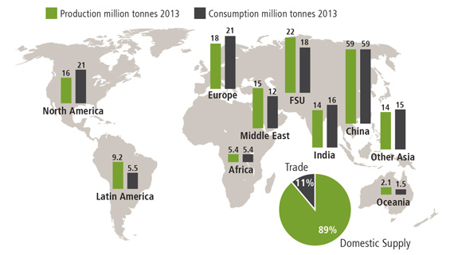
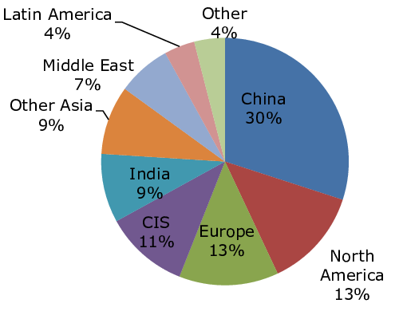
China is the dominant ammonia-producing region with nearly all production upgraded to nitrogen fertilizers and, increasingly, industrial products. The US, Europe and India are major producers and importers as their consumption outpaces domestic production levels.

Slide 9
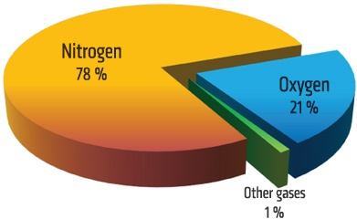
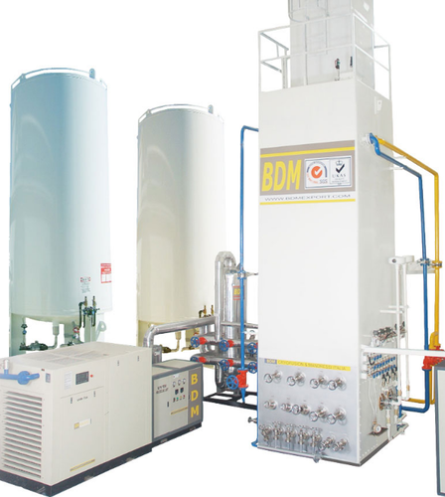
How is ultrapure nitrogen produced for the Industry?
By (a) cryogenic process,
(b) pressure swing adsorption (PSA) using carbon molecular sieves and related processes and
(c) membrane based separation process.
The cryogenic process, which requires high amounts of energy input as electricity, produces N₂ gas with purity levels of 99.9999%. This purity is required for electronic and related industry. This process also is used for generating liquid nitrogen.
At atmospheric pressure, N₂ liquefies at 77K (-195.79 °C, density 1.25) to a colorless liquid and freezes at 63 K (-210 °C). In contrast, O₂ liquefies at 90K (-183 °C) to a pale blue liquid with density 1.42.

Slide 10
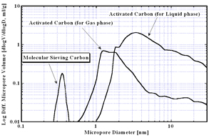
Pressure Swing Adsorption (PSA) using CMS
Molecular Sieving Carbon (MSC) or Carbon Molecular Sieves (CMS)
A carbon molecular sieve (CMS) is the porous skeletal framework of carbon that remains after oxygen free pyrolysis of a polymeric precursor such as polyvinylidene chloride, polyacrylonitrile, phenol formaldehyde or coal.
Activated carbon is generally used for gas and liquid adsorption has well developed micro and transitional pores of 10 to 500 angstrom in pore diameter.
On the other hand, Molecular Sieving Carbon has only uniform supermicro pores of less than 10 angstrom (1 nm) in pore diameter.
Dry air contains 78 % N₂, 21% O₂, 0.9% Ar, 0.04% CO₂
Application of Molecular Sieving Carbon
Molecular Sieving Carbon is widely used for gas separation. One of the most typical applications is nitrogen PSA (Pressure Swing Adsorption). Nitrogen PSA is using velocity separation, which makes use of the difference of adsorption velocity between nitrogen and oxygen. The performance of PSA is largely affected by the property of Molecular Sieving Carbon. It is because the difference of molecular sizes is very small between O₂ (0.28nm×0.39nm) and N₂(0.30nm×0.43nm). The best Molecular Sieving Carbon for N2/O2 separation is precisely controlled so as to have slightly larger pores than N₂. This pore size control results in that the N2 is harder to adsorb and O2 is easier to adsorb.

Slide 11
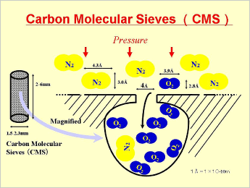
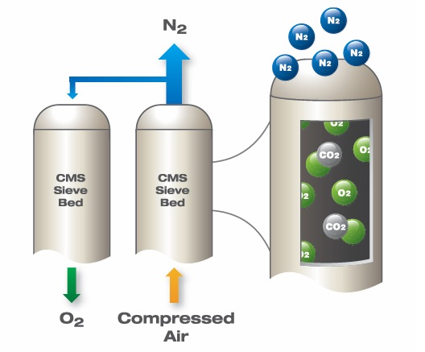
Pressure swing adsorption (PSA) is a process discovered in the 1970’s which provides N₂ gas with purity levels of 95% to 99.9995%. The process which works on the principle of selective adsorption uses a special adsorbent which is carbon molecular sieve (CMS).
Pore size = 3-4 Å
O₂ (2.8×3.9 Å)
N₂ (3.0×4.3 Å ).

Slide 12
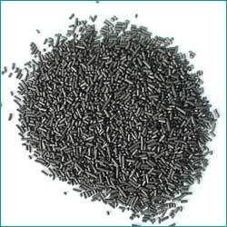
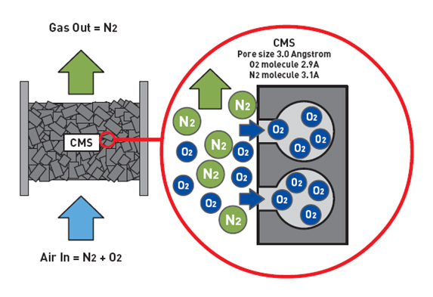
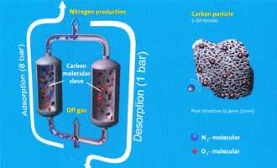
Carbon Molecular Sieves (CMS)

Slide 13
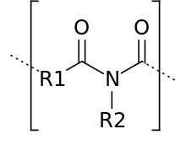
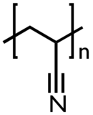
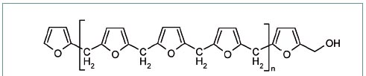
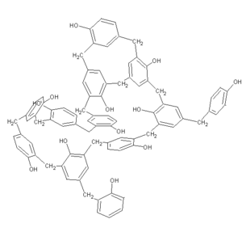
Preparation of CMS
Carbon molecular sieves (CMS) and CMS membranes result from a heat treatment under controlled atmosphere or under vacuum of an organic polymeric precursor. During this heat treatment ( 500-1000 °C) the polymeric chains decompose giving rise to an amorphous carbon skeleton with interconnected pores. The pore size ( less than 1 nm) and its network is responsible for the separation of molecules.
Precursors
Polyimides
Polyacrylonitrile
Phenol-formaldehyde resin
Polyfurfuryl alcohol
Pre-treatment→ Pyrolysis (500-1000 °C)→ Post Treatment

Slide 14
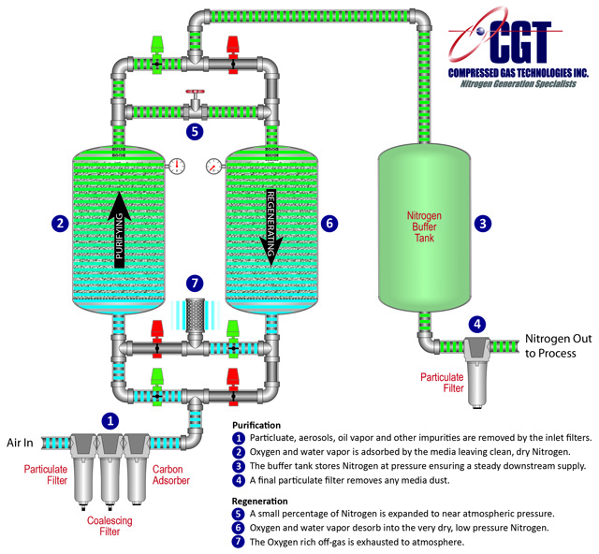
PSA separation
Pretreated compressed air enters the bottom of the on-line tower and follows up through the CMS. Oxygen and other trace gasses are preferentially adsorbed by the CMS, allowing nitrogen to pass through. After a pre-set time, the on-line tower automatically switches to regenerative mode, venting contaminants from the CMS. Carbon molecular sieve differs from ordinary activated carbons in that it has a much narrower range of pore openings. This allows small molecules such as oxygen to penetrate the pores and be separated from nitrogen molecules which are too large to enter the CMS. The larger molecules of nitrogen by-pass the CMS and emerge as the product gas.

Slide 15
Earlier methods for conversion of Nitrogen to useful products
    Birkeland-Eyde arc process for nitric acid (1903)
This process developed by the Norwegian industrialist and scientist Birkeland along with business partner Eyde in 1903, based on a method used by H. Cavendish was used for making nitric acid before the discovery of the Ostwald process. The electric arc (~ 3000 °C) converted nitrogen and oxygen to NO which got converted to NO₂ and further to HNO₃
Frank-Caro cyanamide process for calcium cyanamide

Slide 16
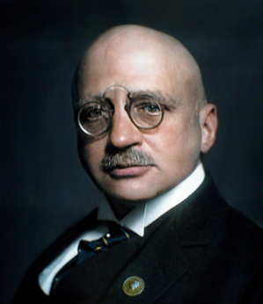
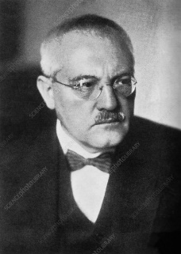
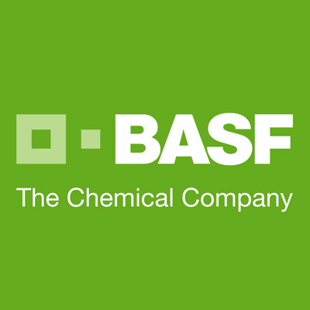
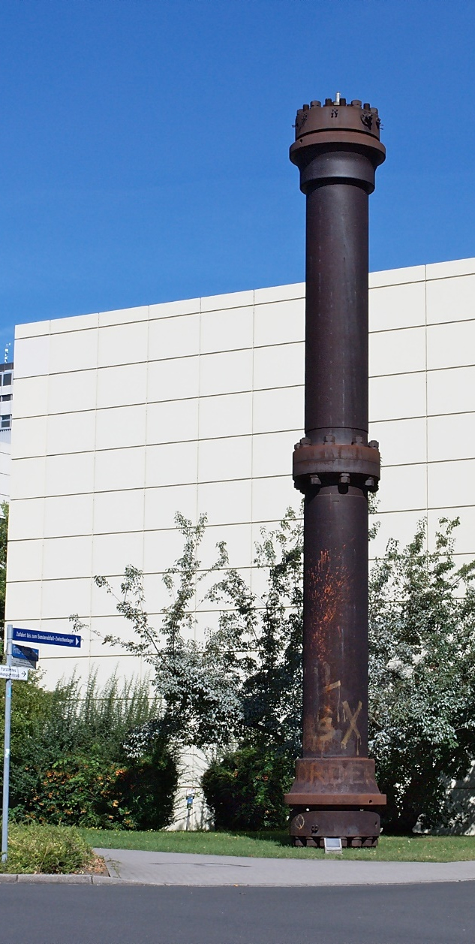
Haber Bosch process for Ammonia
Badische Anilin und Soda Fabrik
Early discovery of Fritz Haber
1909
The method was procured by the BASF company and Carl Bosch of BASF converted the process into the industrial level using a promoted iron catalyst discovered by Allwyn Mittash. Both Haber and Bosch received Nobel prize for their path breaking discovery in 1918 and 1931 respectively.
Current Industrial Process
Catalyst and promoter are used. The catalyst is partially reduced magnetite (Fe₃O₄) encased in a shell of Wüstite (FeO) covered by an iron shell. Promoters such as K₂O, CaO, SiO₂ and Al₂O₃ are also used.
First Ammonia reactor of BASF

Slide 17
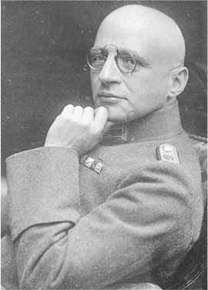
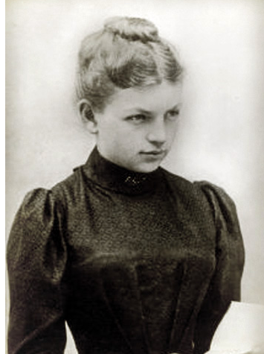
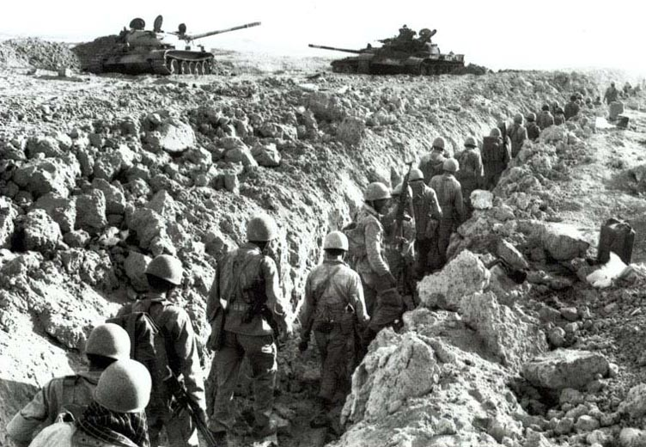
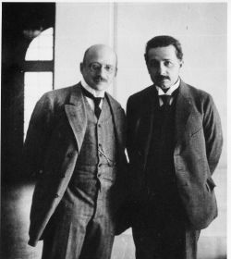
The dark side of the life of Fritz Haber
Haber is also remembered to history as the "father of chemical warfare" for his years of pioneering work developing and weaponizing chlorine gas for trench warfare during World War I. However, his wife Clara Immerwahr, a virtuous lady, and trained chemist and also the first German woman to receive a Ph.D, stridently opposed her husband’s idea of using chemistry for killing human beings. He ignored her protests and went for a kill loaded with chlorine cylinders. She, to register her strong dislike to her husband’s unethical action, took the service revolver provided by the German army to Haber, came out in the garden of her house and shot herself dead.
Dr “Evil”
Clara Immerwahr Haber
Ist woman Ph.D: Germany
Haber with friend Einstein

Slide 18
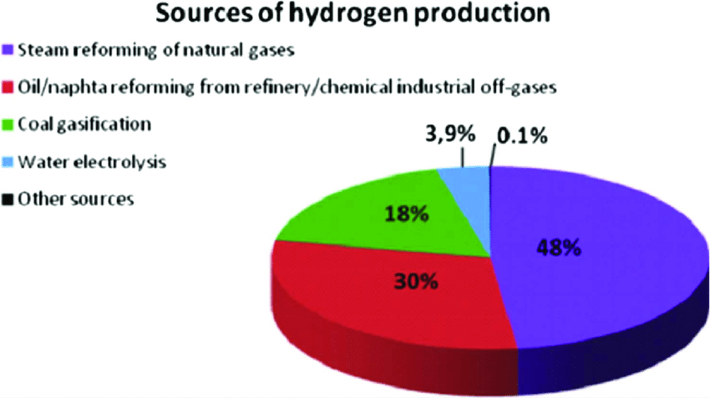
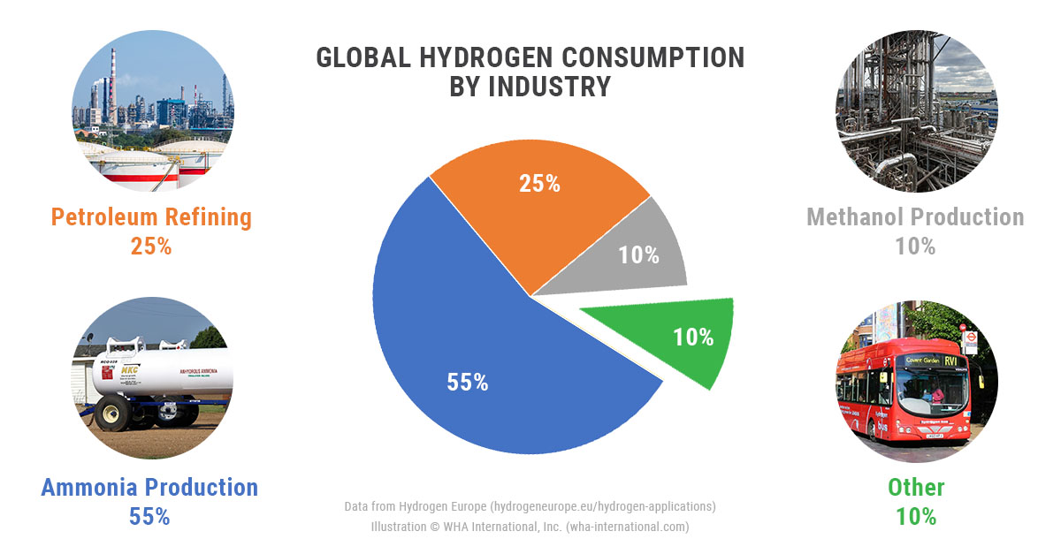

Slide 19
Steps involved in making pure Hydrogen
~50% of the hydrogen produced in the world is used for Haber Bosch Process.
The process releases 3% of the world’s CO₂ emission
For every ton of ammonia produced, 1.87 tons of carbon dioxide is generated which is about 3% of the world’s CO₂ emission
Carbon dioxide removal
(A) Pressure Swing Adsorption using Zeolite 13X
(B) Scrubbing by monoethanolamine
(C) Scrubbing by K₂CO₃

Slide 20
Some interesting facts about the Haber-Bosch process
Approximately 3 out of 7 billion people of the earth would have perished of hunger if sufficient amounts of ammonia was not generated by the Haber-Bosch process for making fertilizers.
One estimate suggests that about 50% of the nitrogen present in the human tissue has had its origins in the Haber-Bosch process some way or the other.
More than 50% of the hydrogen produced in the world is used for the synthesis of ammonia by this process.
Haber- Bosch process consumes around 1% of the world’s energy sources.
For every ton of ammonia produced, 1.87 tons of carbon dioxide is generated which is about 3% of the world’s CO₂ emission. For the records, in 2010, 245 million tons of CO₂ was released to the atmosphere by the process.
Production of hydrogen for the reaction by steam reforming of methane is still the best method for hydrogen generation as electrolysis of water is 12 times more costlier.

Slide 21
Comparison on catalytic activity of different metals for Haber-Bosch process
Fe : 0.72 | Ru: 22.20 | Os: 5.60
Co: 0.40 | Rh: 0.52 | Ir: 0.68
Ni: 0.04 | Pd: 0.00 | Pt: 0.008
Os | Rs 23000/g
Ru | Rs 9700/g
Fe | Rs 7/g
Late transition metals supported on activated carbon along with potassium metal promoter.(ml of NH₃/hr of catalyst (5.0 wt% of carbon) and potassium (25 wt% of carbon) kept at 300 °C and 600 torr: flow rate 4.5 L/hr)
Kellogg advanced ammonia process, KAAP ( British Petroleum)
The catalyst prepared by subliming Ru₃(CO)₁₂ on a carbon support impregnated with rubidium nitrate and the formed catalyst had 5 wt% Ru and 10 wt% Rb. The KAAP process also operates at a lower pressure compared to the iron based processes (90 bar pressure versus 140-170 bar pressure; 375-400 °C versus 400-450 °C), 10-20% more efficient
Haldor- Topsøe Process of Denmark
catalyst involves ternary nitrides such as Fe₃Mo₃N, Co₃Mo₃N and Ni₂Mo₃N. Along with cesium promoters, these catalysts showed catalytic activities 2-3 times greater than commercial iron based catalysts

Slide 22
World production of ammonia was 172 MMT in 2019
85% of all ammonia produced in the world is used for making nitrogen based fertilizers (40% for making urea).
making nitric acid (5%),
polyamides, melamine, polyurethane polymers (5%)
fine chemicals and wood-pulp treatment (5%).

Slide 23
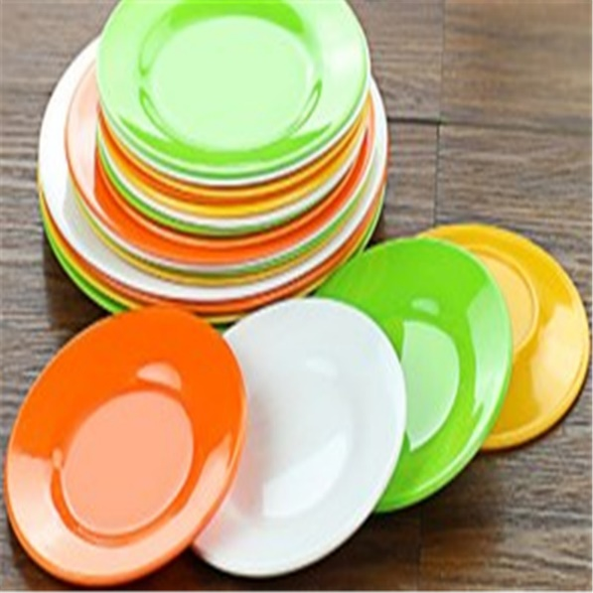

Slide 24
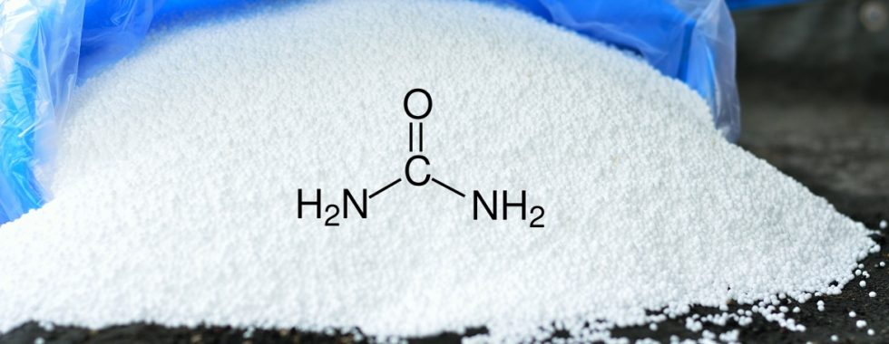
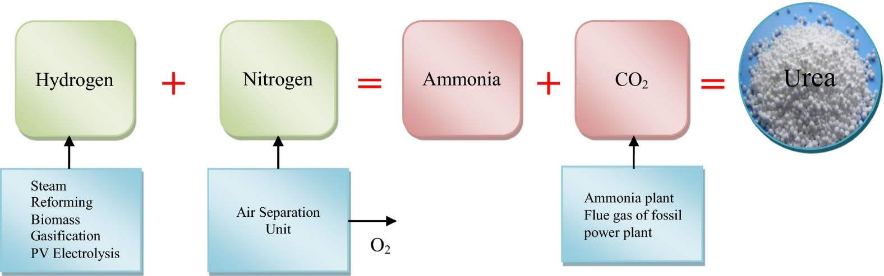
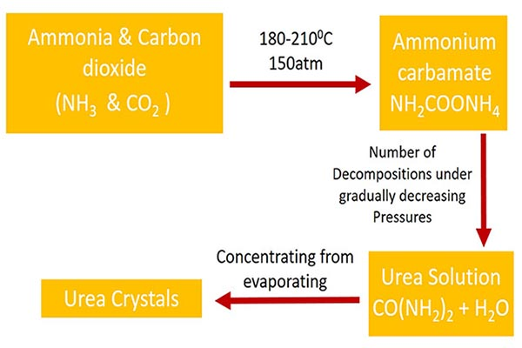
World production of urea was 200 MMT in 2018
Urea
Unlike ammonia, urea is safe and easy to handle, a white solid with a melting point of 135°C
43% of the world production of urea is located in China. Other major urea suppliers at the global market are India (13.5%) and countries of the Middle East Region, such as Qatar, Saudi Arabia, Iran and Oman (about 13%). Europe and the CIS countries produce about 11% of the world reserves of carbamide.
Bosch–Meiser urea process
For Industrial manufacture
Industrial uses of Urea
Fertilizer
Urea formaldehyde and melamine-formaldehyde resins
Diesel Exhaust Fluid
De-icing of roads
Component of animal feeds
Creams, moisturizers, hair removers
Medicinal creams for psoriasis, eczema
Urea-potassium carbonate –fire proofing
History
1727: first observed in evaporated urine
1773: first crystallized from urine by extraction with alcohol
1828: Wohler prepared urea from silver cyanate and ammonium chloride

Slide 25
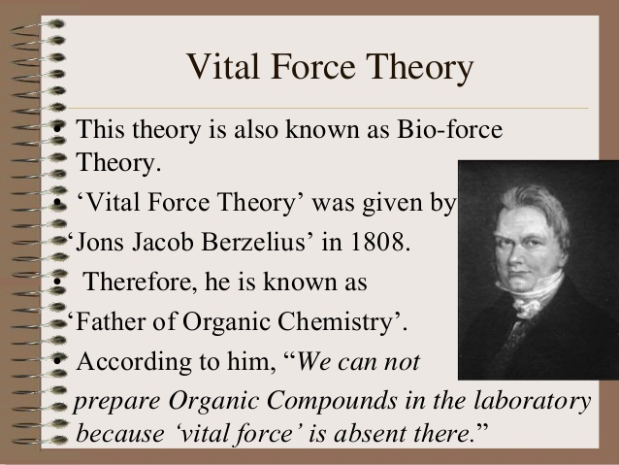
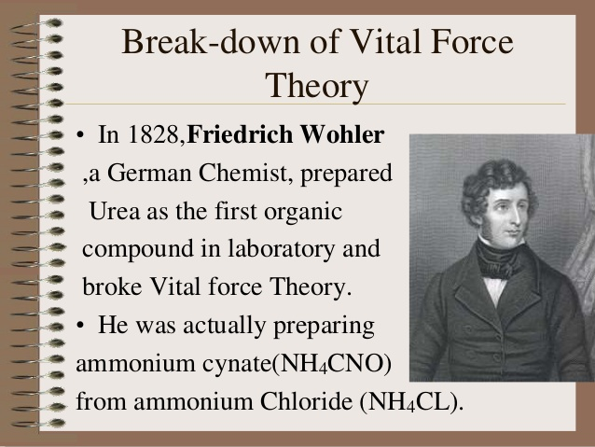
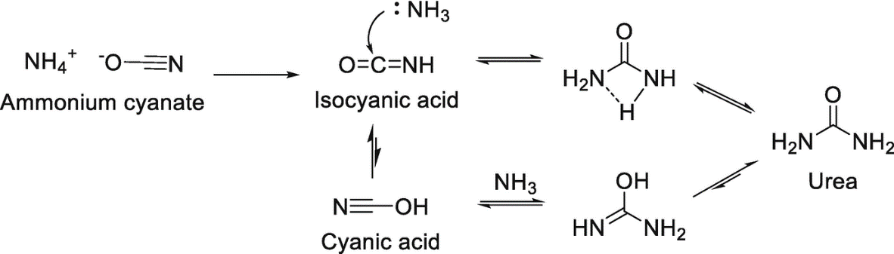

Wӧhler wrote to his contemporary Berzelius: “I must tell you that I can make urea without the use of kidneys, either man or dog” . Ammonium cynate (NH₄NCO) is urea!
1828 Wӧhler, the father of synthetic organic chemistry prepared urea by the reaction of silver cyanate with ammonium chloride which debunked the vitalism theory prevalent during that period and assumed that chemicals produced by living organisms are fundamentally different from that of lifeless objects.
Heat

Slide 26
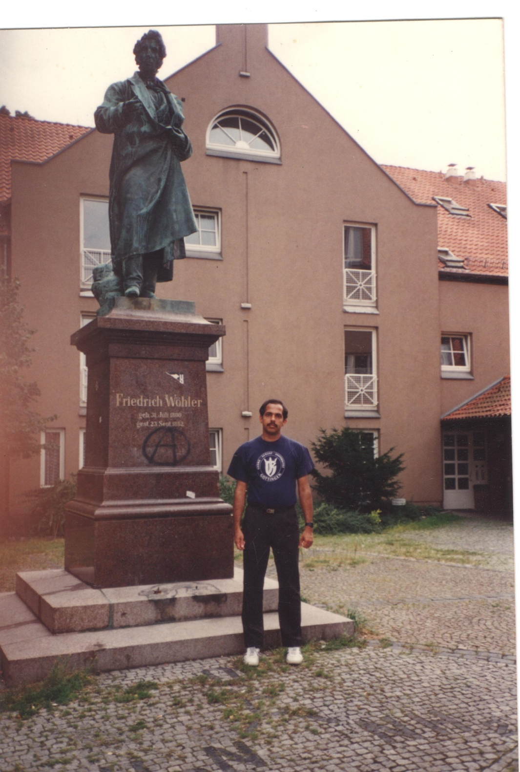
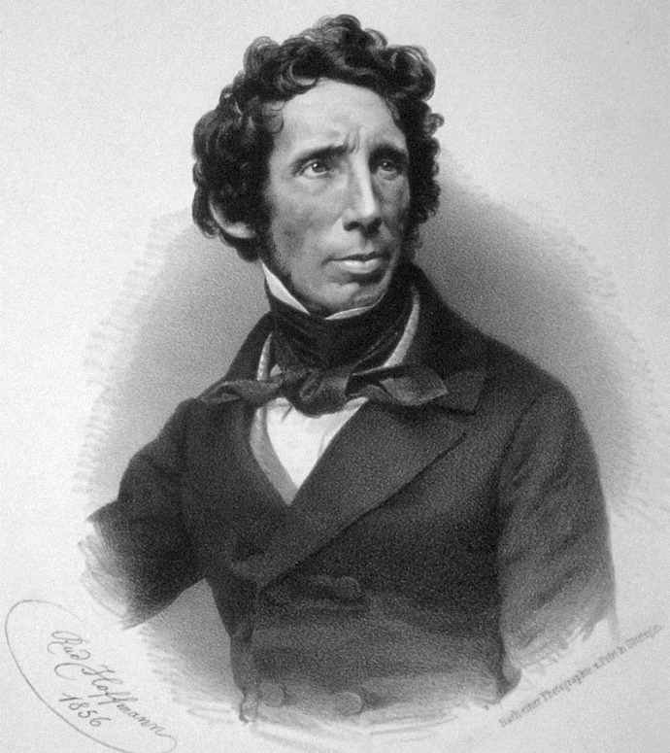
Friedrich Wöhler was professor at the University of Göttingen, Germany for 21 years from 1836. He remained affiliated to the University of Göttingen for 21 years. During this period he is said to have trained around 8000 students in his laboratory.
Beryllium, Yttrium, pure Al, Silane, SiC, Silicon nitride, BN, CaC2, N3P3Cl6, etc…..
Your teacher at the feet of the statue of Wöhler at Göttingen, Germany ☺

Slide 27

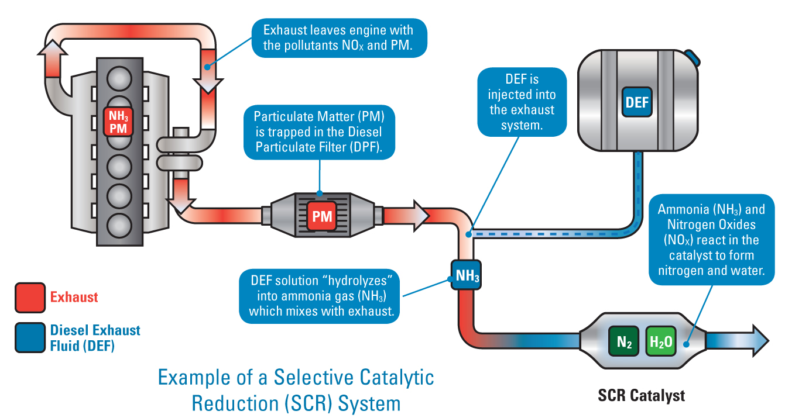
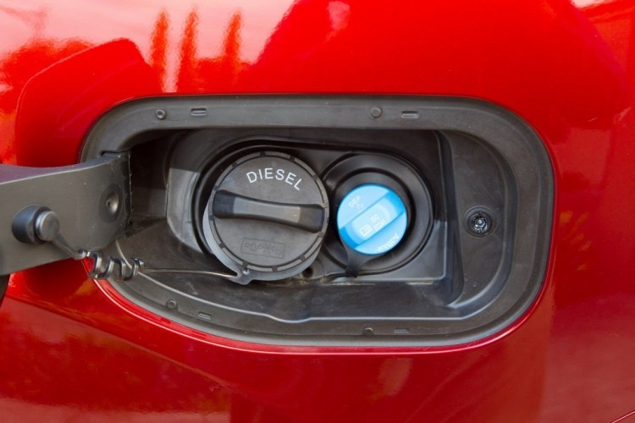
Diesel Exhaust Fluid
A 32.5% aqueous solution of urea in demineralized water which is used as a consumable for selective catalytic reduction of nitrogen oxides in the diesel exhaust emission of diesel engines

Slide 28


Selective Catalytic Reduction (SCR) for Nitrogen Oxide (NO_{x}) Removal
The SCR process is one of catalytic reactions, where single metal oxide, mixed metal oxides and supported metal oxides, and pure or metal-exchanged zeolites catalysts are generally used to convert nitrogen oxides (NO_{x}) into nitrogen molecule (N₂) and water (H₂O), which are harmless not only to human being but also the environment, by using suitable reducing agents such as ammonia, urea, hydrocarbon and hydrogen
Figure shows urea decomposition reaction to ammonia and isocyanic acid (HNCO), which usually occurs under thermal reaction even without any catalysts, along with two byproducts namely biuret and cyanuric acid at moderate temperature of 300 °C. HNCO is a stable intermediate species in the gas phase but hydrolyzes to NH₃ and CO₂ on the TiO₂/ZrO₂-based SCR catalyst.
The order of catalyst activities according to the reaction is:
Urea thermolysis: TiO₂ > H-ZSM-5 ≈ Al₂O₃ > ZrO₂ > SiO₂
Urea hydrolysis: ZrO₂ > TiO₂ > Al₂O₃ > H-ZSM-5 > SiO₂

Slide 29




Oxides of Nitrogen
N₂O, NO and NO₂ are relatively more stable compared to the others. NO is paramagnetic in the gaseous phase and forms a weak dimer in liquid and solid phases mostly of the type ONNO which is diamagnetic.
N₂O₃ b.p. 3.5 °C
N₂O₅ m.p.41 °C

Slide 30




Nitrous oxide, a colorless gas which is quite unreactive at room temperature was discovered by Joseph Priestley by reduction of NO using Fe or Fe/S mixtures. The compound commonly known as ‘laughing gas’ has many beneficial applications especially as an inhalation anesthetic in medicine and dentistry. In the presence of heated catalysts above 577° C, N₂O decomposes to give N₂ and O₂ accounting for its high temperature reactivity. The ‘barking dog reaction’ is a classic example of its high temperature chemistry. The sound of a dog barking is produced when a mixture of CS₂ and N₂O is ignited in a long measuring vessel giving, N₂, S₈ and CO₂.

Slide 31




Endothelium derived relaxing factor (EDRF): Nitric Oxide!
Nitric oxide synthase produce NO by catalyzing a 5e oxidation of a guanidino nitrogen of L-arginine (L-Arg). Oxidation of L-Arg to L-citrulline occurs via two successive monooxygenation steps producing N-hydroxy-L-arginine as intermediate. 2 mol of O₂ and 1.5 mol of NADPH are consumed per mole of NO formed
The Nobel Prize in Medicine in 1998 was awarded to F. Murad, Robert F. Furchgott, and L. Ignarro for resolving the mystery of EDRF and determining the signaling properties of nitric oxide

Slide 32




The production of nitric acid before the Ostwald process
Source of nitrogen compounds
Before the synthesis of ammonia
Iron pyrites (fools gold) FeS₂
Green Vitriol FeSO₄. 7H₂O
Guano (Salt peter, KNO₃)

Slide 33

Friedrich Wilhelm Ostwald
Ostwald received the 1909 Nobel Prize for Chemistry for his contributions to understanding catalysis and for his investigations of the fundamental principles underlying chemical equilibria and reaction rates
In the 1880s Wilhelm Ostwald studied the speeds of numerous chemical reactions, including reactions occurring in the presence of acids and bases. In 1894 he revealed what happens: a substance - a catalyst - can affect a chemical reaction's speed, but is not included in its end-products.
In 1901, Albert Einstein applied for a research position in Ostwald's laboratory. This was four years before Einstein's publication on special relativity. Ostwald rejected Einstein's application, although later the two developed strong mutual respect.
Ostwald is famous for Ostwald viscometer, Ostwald process (nitric acid manufacture), Ostwald dilution law, for introducing the concept of mole and many more

Slide 34




Ostwalds Process : Industrial production of Nitric acid

Slide 35






Christian Friedrich Schönbein
HNO₃ + H₂SO₄
The accidental discovery of gun cotton or nitrocellulose goes to the credit of Christian Friedrich Schönbein a German-Swiss chemist of Basel, who in 1846, after cleaning up a spill of concentrated nitric acid and sulfuric acid on the kitchen table with a cotton apron hung the apron on the stove door to dry. As soon as it was dry, there was a flash as the apron ignited and burned without smoke. Nitrocellulose after slight modification in processing was used as smokeless powder for guns.

Slide 36





Nobel's Explosives Factory, Ardeer, c1887. The process of nitrating glycerine is exothermic creating heat, and required the circulation of cooling water to maintain a safe temperature. The one-legged stool was therefore a safety device designed to prevent the operator from falling asleep, thereby ensuring that he paid close attention to the thermometer.

Slide 37




How Alfred Nobel tamed Nitroglycerin
On September 3, 1864, an explosion occurred in Nobel's laboratory, which was situated in his home, on the outskirts of Stockholm. Five people were killed, including 21-year old Emil Nobel, Alfred's youngest brother. As a result of this accident the city of Stockholm enforced laws that experiments with explosives could not be made within the city limits of Stockholm. Nobel therefore temporarily continued production on a barge anchored in Lake Malaren to the west of Stockholm.
Nobel began now searching for a porous material, which would absorb nitroglycerine without diminishing its explosive capacity. Of the many materials tested (porous silica, paper, paper pulp, wood waste, brick dust, coal, dry clay, etc.), kieselguhr (a porous diatomaceous earth) turned out to be the most appropriate. It was chemically inert and would easily absorb up to three times its weight of nitroglycerine; the resulting putty-like substance could be shaped into sticks ready for the user
Robert and Ludvig became engineers, while Alfred studied chemistry. His chemistry teachers were Professors Nikolai N. Zinin and Yuli Trapp. Professor Zinin later drew Alfred and Immanuel’s attention to nitroglycerine
Nobel brothers (clockwise) Robert, Alfred, Ludvig and baby Emil

Slide 38



Nobel's kieselguhr dynamite was not quite the perfect solution: 25% of this composite dynamite was non-explosive. Afterwards two groups of dynamites were developed: (a) dynamites with an inert absorbent, e.g., kieselguhr dynamite and, (b) dynamites with an active absorbent.
(substances such as sodium, potassium, and ammonium nitrate, chlorates, and black powder) or a non-explosive material under ordinary conditions (sawdust, sugar, and coal) which in the presence of a powerful explosive like nitroglycerine contributes to the energy release.
Nobel in 1875 invented a more powerful form of dynamite, blasting gelatin, which he patented the following year. Blasting gelatin is a gel-like mixture of nitrocellulose with nitroglycerine
Nitroglycerin for chest pain!!
“My heart trouble will keep me here in Paris for another few days at least, until my doctors are in complete agreement about my immediate treatment. Isn't it the irony of fate that I have been prescribed [nitroglycerin], to be taken internally! They call it Trinitrin, so as not to scare the chemist and the public”. Alfred Nobel

Slide 39
Excerpts from Alfred Nobel’ s Will……………
All of my remaining realisable assets are to be disbursed as follows: the capital, converted to safe securities by my executors, is to constitute a fund, the interest on which is to be distributed annually as prizes to those who, during the preceding year, have conferred the greatest benefit to humankind. The interest is to be divided into five equal parts and distributed as follows: one part to the person who made the most important discovery or invention in the field of physics; one part to the person who made the most important chemical discovery or improvement; one part to the person who made the most important discovery within the domain of physiology or medicine; one part to the person who, in the field of literature, produced the most outstanding work in an idealistic direction; and one part to the person who has done the most or best to advance fellowship among nations, the abolition or reduction of standing armies, and the establishment and promotion of peace congresses. The prizes for physics and chemistry are to be awarded by the Swedish Academy of Sciences; that for physiological or medical achievements by the Karolinska Institute in Stockholm; that for literature by the Academy in Stockholm; and that for champions of peace by a committee of five persons to be selected by the Norwegian Storting. It is my express wish that when awarding the prizes, no consideration be given to nationality, but that the prize be awarded to the worthiest person, whether or not they are Scandinavian.
As of now, this will and testament is the only one that is valid, and revokes all my previous testamentary dispositions, should any such be found after my death.
Finally, it is my express wish that following my death, my arteries be severed, and when this has been done and competent doctors have confirmed clear signs of death, my remains be incinerated in a crematorium.
Paris, 27 November, 1895 died in 1896, left nine million dollars for the NOBEL prize
current NOBEL prize money each SEK 10 million (₹8.3 crores)
Alfred Bernhard Nobel

Slide 40


What are the properties needed for an explosive?
The most common property of explosives is their ability to release a large amount of energy in the form of heat and pressure under the specific conditions of heat, shock, friction, electrostatic discharge, etc. The reaction is self-sustaining once initiated and accompanied by the generation of very high temperature (~3000-5000 °C), humongous expansion of released gases in a few microseconds, shock and loud noise. As per Gay Lussac’s pressure-temperature law, a proportional temperature-pressure increase is ultimately relieved in the form of an explosion.
It is worthwhile to note that release of heat without sufficient rapidity can’t be considered as an explosion. For example, although burning of coal releases approximately five times as much heat as an equivalent amount of nitroglycerin, but the rate at which coal releases heat is very slow and therefore, coal cannot be described as explosive.
TNT is an explosive as it releases energy with sufficient rapidity
Coal is not an explosive as it releases energy without sufficient rapidity

Slide 41
Common Explosophores
Explosophores : Energy rich functional groups which are usually attached to a carbon rich backbone in a traditional explosive. The back bone will act as the fuel.
Nitro (-NO₂), nitramine (-NHNO₂), azido (-N₃), amino (-NH₂), nitrito (-ONO₂), azo bridges (-N=N-), azoxy [-N=N(O)], dinitromethane [-CH(NO₂)₂] and trinitromethane [-C(NO₂)_{3.}

Slide 42
Classification of explosives

Slide 43

Primary Explosives
Primary explosives usually explode or detonate when they are heated or subjected to shock. They do not burn and often may not contain elements necessary for combustion and the explosion results even if they are not confined to a space. Primary explosives are extremely sensitive to stimuli such as friction, impact, static electricity, heat, or electromagnetic radiation. A relatively small amount of energy is only required for their initiation.
As a practical measure, primary explosives are sufficiently sensitive that they can be reliably initiated with a blow from a hammer. Primary explosives are often used in detonators or to trigger larger charges of less sensitive secondary explosives and are commonly used in blasting caps and percussion caps to translate a physical shock signal.
Was the blasting cap in Nobel’s dynamite
The most common detonator in guns and military artillery
The detonator in small arms military ammunition

Slide 44
Secondary Explosives
Secondary explosives or high explosives, on the other hand detonate only under the influence of the shock of the explosion of a primary explosive. Not all of them are combustible and most of them can even be ignited by a flame and generally burn without vigor and can be extinguished also easily. They differ from primary explosives in not getting exploded by simple heat or shock and requires substantially more energy to be initiated and when exploded using a primary explosive are more brisant and powerful. Some secondary explosives have also other applications (e. g. as fertilizers) and are safe to handle and store.

Slide 45


If it is just heated it will get converted to N₂O and H₂O and is the standard method for preparation of N₂O. There are many more ways by which ammonium nitrate can decompose as shown in scheme
Ammonium Nitrate: An explosive fertilizer !!!
Texas city 1947 Amm. Nitrate ~3500 tonnes
Beirut city 2020 Amm. Nitrate
2750 tonnes
https://www.youtube.com/watch?v=FnSr820S2Mk

Slide 46
Evaluation of explosives
Energetic properties of an explosive are determined by measuring its density, heat of formation, detonation velocity and detonation pressure. Detonation velocity or velocity of detonation (VoD) is the velocity at which the shock wave front travels through a detonated explosive, whereas detonation pressure (DP) is the peak dynamic pressure in the shock front. Both of these important parameters depend on the molecular formula of explosive, values of heat of formation (ΔH_{f}) and density. Density of an explosive is a highly important parameter as both VoD and DP are directly proportional to the value of density and (density)², respectively. The typical detonation velocity (VoD) of explosives ranges from 2700 to 10,000 m/s. some of the explosives very high VoD are shown below

Slide 47
Synthesis of primary and secondary explosives by nitration using nitric acid

Slide 48
Oxygen Balance
The oxygen balance provides information on the oxygen requirement of an explosive. A large and negative oxygen balance indicates that there is not sufficient oxygen for carbon dioxide to be formed. As a result, carbon monoxide can get liberated. Oxygen balance can be defined as the amount of oxygen expressed in weight percent liberated when an explosive material is completely converted to CO₂, H₂O, N₂, SO₂, Al₂O₃ etc. With regard to oxygen balance (OB%), zero percent oxygen balance is the situation required for a very strong explosive which is achieved when all of C gets converted to CO₂, all of H gets converted to H₂O, N to N₂ and all metals to stable metal oxides with no excess of oxygen remaining or having deficiency in oxygen.
Where X = number of carbon atoms; Y = number of hydrogen atoms; Z = number of oxygen atoms and M = number of atoms of metal (which gets converted to oxide)

Slide 49
In general a stronger explosive will be having some or all of the following features
Higher velocity of detonation (VoD)
Higher density
Zero oxygen balance (OB%) indicating a good fuel to oxidizer ratio.
4. Higher volume of gases generated
Often a combination of an oxygen excess explosive with calculated amounts of fuel can result in better performance and lesser sensitivity and ease of handling. (e.g. ANFO (94% AN + 6% fuel oil)has better performance (VoD = 5270m/s) than AN (VoD = 2550 m/s).

Slide 50
Challenges in chemical research of Nitrogen: Making more powerful explosives and polynitrogen compounds
For further reading: link below
https://www.ias.ac.in/article/fulltext/reso/024/11/1253-1271
RESONANCE | November 2019

